Slide 2
Machine Learning <3 Real-Time Data Analytics
Alexander Slotte @alexslotte

Slide 3

Originally from Sweden, Alexander has 10+ years of professional software development experience, solving problems for a wide range of industries. He currently works as a Lead Consultant at Excella, and is the organizer of the .NET DC user group. He thoroughly enjoys speaking at conferences, meetups and local user groups He is particularly passionate about .NET and cloud development, and constantly attempts to push his knowledge on real time data streaming, data science and machine learning, as this has for a long time been an interest of his. When not coding, you'll find him out running or enjoying a good IPA!
Alexander Slotte
@alexslotte

Slide 4
Excella is an Agile technology firm and transformative partner to Washington, DC’s leading organizations. Since 2002, federal agencies, prominent brands and trailblazing non-profits have turned to Excella to transform bold ideas into elegant technology solutions. We believe technology exists to solve challenges and evolve thinking – we help organizations harness this power to make real progress. Learn more at www.excella.com.

Slide 5
Agenda
Part 1 (50 min)
Introduction to Machine Learning/ML.NET
Train our model in ML.NET
Break (5-10 min)
Part 2 (50 min)
Introduction to Stream Processing
Setup our Azure Stream Analytics job
Break (5-10 min)
Part 3 (50 min)
Introduction to Azure ML Service
Train our model in Azure ML Service

Slide 6

bit.ly/2Pc1HgC
Get started

Slide 7
What do you identify youself as?

Slide 8
How familiar are you with Machine Learning?

Slide 9
How familiar are you with Stream Procesing?

Slide 10
How familiar are you with Azure?

Slide 11
Part 1
Machine Learning and ML.NET

Slide 12
Agenda
Part 1 (50 min)
Introduction to Machine Learning/ML.NET
Train our model in ML.NET

Slide 13
What is Machine Learning?
Notes:
So what is Machine Learning?
Machine Learning is all around you today and you can see it in everything from a simple applications such as a spam filter in your inbox, to your Google Home or Alexa. It is commonly used in medical diagnostics, self-driving cars, stock market analysis and various recommendation engies, e.g. Netflix or Spotify.
Facebook and Goggle are by fare the market leaders in AI and Machine Learning, although companies such as Microsoft is quickly catching up.

Slide 14

Notes:
One which is provided by Google, and I find particularly interesting is an game in which the application will challenge you to draw a given picture in less than 20 seconds, for example a flag.
The algorithm will keep guessing what it thinks you are drawing as you go along, and it will hopefully be able to guess the correct answer.
I recorded my interaction with algorithm to show you how it can work. You can see the guesses the algorithm are making at the bottom of the video.

Slide 15


Notes:
Machine Learning have for a long time been fairly foreign to Software Engineers, and especially those working in C# or F#.
Animation
The dominant languages to use when training your Machine Learning models are Python and R.
Although both of these are fantastic languages and rightfully popular, it causes problems for .NET Developers as we not only need to learn totally new concepts in the Machine Learning domain, but we also need to learn one or more new languages.
Machine Learning models written in R and Python doesn’t integrate that well with existing DevOps pipeline, nor are they easy to integrate in to your existing application to use.

Slide 16
“Field of study that gives computers the ability to learn without being explicitly programmed.”
Arthur Samuel (1959)
Notes:
Defining what Machine Learning is, is not a trivial task. There are, and have been many definitions of what machine learning is over the years.
A prominent figure in the Machine Learning space in the 1950's Arthur Samuel, defined machine learning as the field of study that gives computers the ability to learn without being explicitly coded.
What machine learning is really all about is teaching a mathematical model to make decisions on real-world data, in such a way that it can make accurate predictions on incoming new data that the model was not trained with.
We can for example train a model on a large number of animal pictures, in the hopes that our trained model will from now on be able to detect if a specific animal is a picture or not.
Artifical Intelligence expert argue that machine learning is the best way forward towards human-like AI

Slide 17
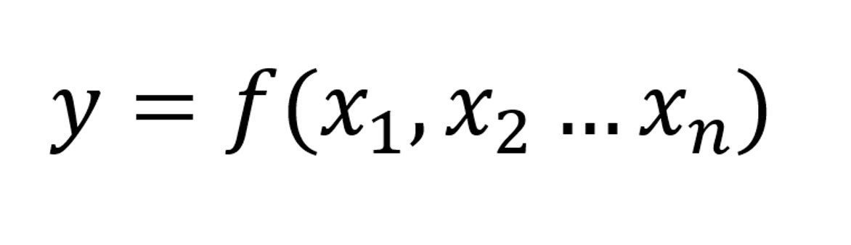
Notes:
You may have heard the term "train your model" been mentioned quite a few times in this talk already. So what does that really mean?
Training your model means to use a large set of data, to accurately create a mathematical representation, or model, of a real-world process, in such a way that the predicted outcome is as accurate as possible.
In other words, we are creating a function f, based on variables x1 to xn that gives us an accurate y.
- Next slide (animation)

Slide 18
Features
Label
Notes:
- Next slide (animation)
In the machine learning world, x1 to xn are called features, or a feature set, and the predicted outcome is called label.
To give an example, x1 to xn may be properties of a house, e.g. number of bedroom, square footage and number of bathrooms, while y may be the predicted price.
We would then need to fit a function given those sets of input variables such that the house price can accurately be predicted
The algorithm used to create the function varies depending on what Machine Learning task you are trying to accomplish, e.g. classification vs regression.
Although ML.NET makes it a lot easier to pick up Machine Learning, I've found it useful to learn the basic terminology in the domain, as you'll frequently see it referenced in the code.

Slide 19
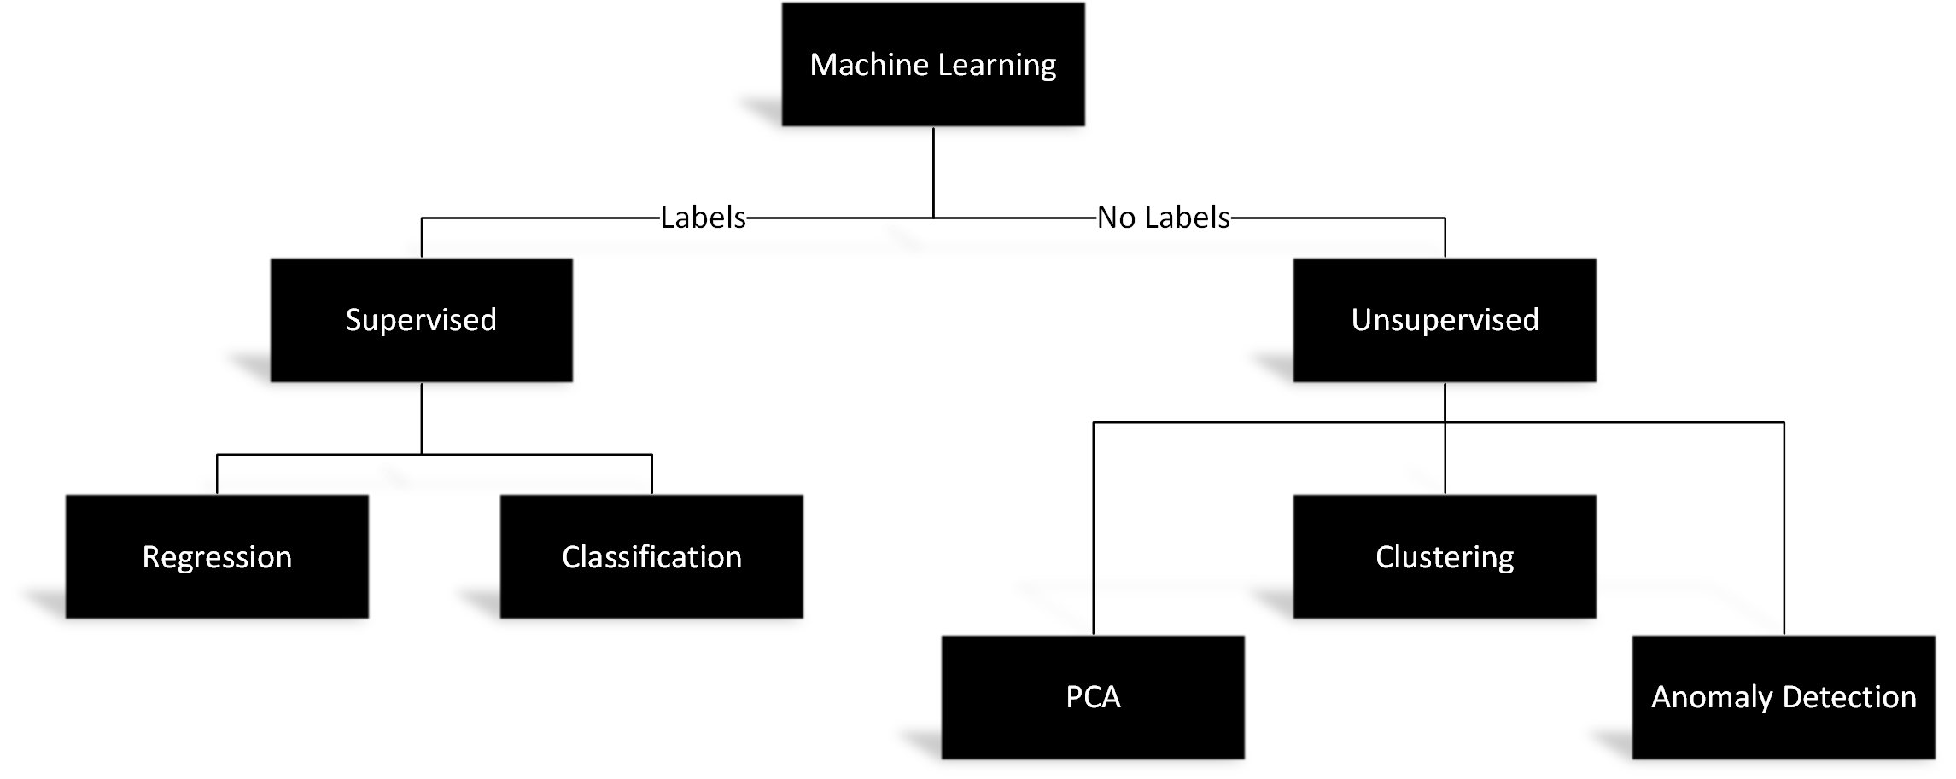
Supervised vs Unsupervised
Notes:
There are different types of machine learning. The two most commons ones that you may have heard of, is supervised and unsupervised machine learning, although concepts such as reinforcement learning also exist.
In supervised learning, we are doing our best to teach the computer to do something specific.
At our disposal, we not only have the data necessary to train our model, but we also have the known answer, often referred to as labels.
A good example of this may for example be creating a model that classifies e-mails as important or not.
In order to create this model, we would need to have a large set of e-mails, already labeled as important or not important.
We would then be able to use a supervised machine learning task, such as classification, to train our model on, and creating a model that accurately labels e-mails.
Unsupervised learning is the case where the correct answer is not known, and the computer teaches itself. Clustering, Principal Component Analysis and Anomaly Detection are good examples of unsupervised learning.

Slide 20
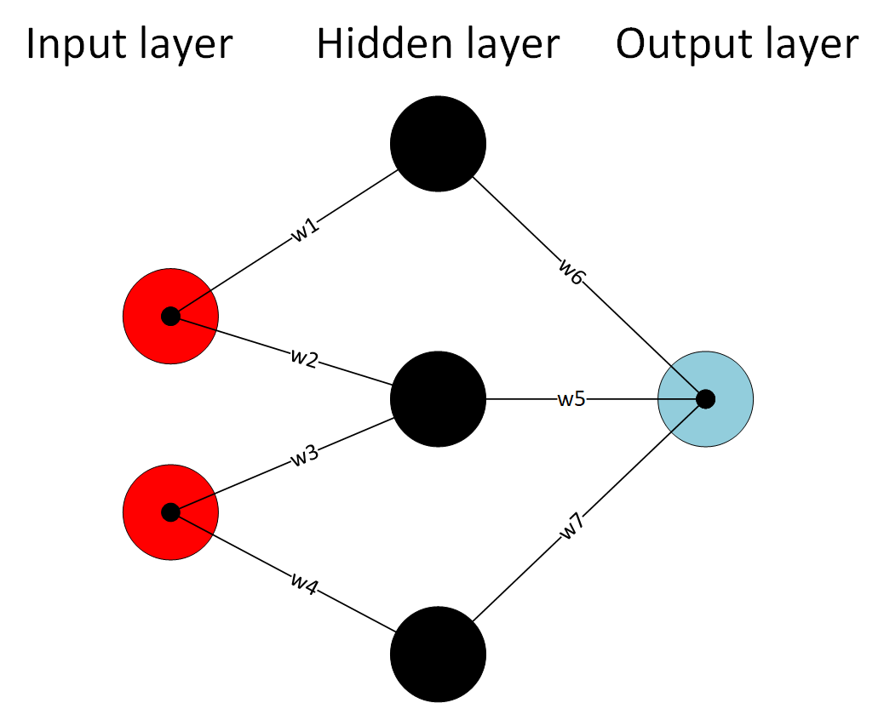
Deep Learning – Neural Networks
Notes:
Deep learning can be seen as Machine Learning on steroids, and is commonly implemented by a concept called artificial neural networks, or ANNs.
ANNs consist of a number of simple nodes or neurons, organized in a deep layered structured.
Each neuron is connected with other neurons, and performs a designated function. The importance of that specific function or neuron is controlled by multiplying the input value with a given weight, say w1 to wn and adding a bias.
Each type of neural network will have its own specific structure. Structuring the neural networks in different ways is beneficial depending on what problem you are trying to solve, for example computer vision or natural language processing.
Neural network are very powerful, as they allow the computer to explore and find patterns that are too complex to manually extract or teach a machine to recognize. Neural networks as a concept is nothing new, and has actually been around for quite a while. It just until recently though that the computer power to train these models exists, and the waste amount of data needed is available. Training a complicated deep learning model, even with today's hardware can take days or more.
The way a supervised neural network learn is through a process called backpropagation.
What this really means, is that a given scenario is run through the neural network multiple times during training.
At each time that the neural network reaches the output layer, it will calculate something called a loss function.
This is simply just a function to determine how far away its predicted outcome was from the correct answer. Remember that in supervised learning, we know the correct answer.
Based on how far away from the correct answer the model was, it will perform a process called backpropagation and automatically adjust it's weights and biases to attempt to reach a more accurate prediction.
ML.NET does currently not support the training of deep learning models, but it does support the integration and consumption of already trained models. The most commonly used framework to train deep learning models in is Tensorflow, which is Google's flagship.
If you are interested in Deep Learning, there are some great resources out there to learn, and you an even interact with Deep Learning algorithms yourself to see how they work.

Slide 21

How to build your own model
The Machine Learning Workflow
Notes:
Alright, so we have now covered most of the basics of machine learning, but what is the actual process for building your own model, in a framework such as ML.NET or even Scikit learn or another Python based library?
How can you get started today?

Slide 22

Identify your problem
Notes:
The first step is to identify your problem. What are we trying to solve?
Are we doing text analysis such as sentiment analysis or text classification? Are we trying to decide how customers in your client base are similar and in what way? Are trying to create a model that can determine what breed a dog is just based on an image?
Depending on your problem, there will be different requirements on the data you'll need to collect as well as which machine learning task or training algorithm you may need to use.

Slide 23

Gather your data
Notes:
Once you've determined your problem, the next step will be to gather you data. This is in my opinion the most important step of them all. The accuracy of your model greatly depends on the provided data.
If the model does not have enough data to train on, it will not be able to make good enough predictions.
Similarly,if the data is biased or sqwed, the predicted outcome will also be biased.
Lets say that your for example are training a model to determine the likelihood of a person committing a crime but your data only contain individuals convicted of a crime from a specific demographic group. Doing so will create a biased model, as the model has been trained that this specific group is more likely to commit a crime although the data may not be representative of the larger picture.
In this step we want to make sure to capture as much data and make our dataset as wide as possible to make sure our model accurately can account for any known variance.

Slide 24

Split your data
Notes:
Once you've collected your data, we want to divide it.
A common practice when working with especially supervised learning, is to split your dataset in to two buckets, usually at a ratio of 70 and 30%.
70% of your data will be used to train your model, while the remaining 30%, which the model is not aware of, will be used to evaluate the model to determine how accurate it is in predicting a gven outcome.
We will see how this is done in practice once we start coding with ML.NET in just a little bit

Slide 25

Transform your data
Notes:
Machine Learning algorithms are very very picky. They do not like dirty data, and they only work on float vectors. Thus we are tasked with the job of transforming our data before we can have our machine learning algorithms work on it. This is a very important step, as this is where we ensure data quality going in.
Common things that we normally would like to do here is to replace any missing values in a data column, or normalize variables to a value between 0 and 1. We also want to make sure to transform non-float values to floats. We can do this with for example a technique called Categorical OneHotEncoding. OneHotEncoding takes a non-float value variable, say for example the make of a car in a dataset, and creates additional binary columns, say IsMazda (with a value of 0 or 1), IsAudi (with a value of 0 or 1) and so forth.
This offers a huge performance boost for the machine learning algorithms and transforms the data to a language that the algorithm can understand and work on.

Slide 26

Train your model
Notes:
Once you have your data in a neat and clean format, it's time to train your model.
Training your model basically means choosing which algorithm you want to use when attempting to fit your data. There are tons of alternatives out there, some are better than others in different scenarios, you may for example want to use an average perceptron for binary classification cases, while other are available for clustering or regression. At first, it can seem very daunting to know what algorithm to chose here, and I would just like to make a couple of quick notes on that.
Firstly, this process involves a lot of trial and error – once you have trained your model, you will be able to measure how accurate it is, and if need be, you can just go back and chose another algorithm.
Secondly, the Microsoft documentation is very useful to help you navigate which algorithm to chose in which scenario
Third and lastly, techniques such as AutoML which ML.NET support, completely elevates this process as it will automatically discover which learning algorithm best fits your dataset.

Slide 27

Evaluate your model
Notes:
- We need to measure the accuracy of our model so we know if we need to improve it
- We use our test data set to do this

Slide 28
Evaluate your model
Accuracy
Mean-Squared Error
Precision
Recall
Confusion Matrix
Notes:
- We need to measure the accuracy of our model so we know if we need to improve it
- We use our test data set to do this
- Precision and Recall

Slide 29

Deploy your model
Notes:
Once you're happy with the accuracy of your model, it's time to put it to work.
This is one of the beauties with ML.NET, as it allows us in minutes to deploy out model as part of an ASP.NET Core application, an Azure Function or integrate it in other ways in to your existing .NET application.
Once the model is in operation, it is important to monitor the performance of the model and iteratively evaluate and improve it with more data as needed.
A good example of this would for example monitor which e-mails a user manually labels as spam, so that your model is able to detect this in the future.

Slide 30
ML.NET
Notes:
So if we apply this workflow to ML.NET, how would it look?

Slide 31

ML.NET
Machine Learning Framework for .NET
Open-Source & Cross-Platform
Custom Machine Learning Models
Extensible Framework
AutoML + UI Tools
General Availability v1.0
Notes:
To solve this problem, and to enable .NET Developers to take advantage of the opportunities AI and Machine Learning offers, Microsoft spent a ton of time into developing ML.NET and releasing it to the public.
ML.NET is an open source library that runs anywhere, on Windows, Linux or Mac. If you would like, you are able to contribute yourself by submitting pull requests or issues to their Github repo.
A key differentiator from other Machine Learning products in Microsoft's catalogue is that it allows developers to build custom machine learning models, as opposed to pre-trained models offered by Azure Cognitive Services. The framework is also extensible, meaning that you don't need to train all your models in ML.NET before using them, but you can also leverage pre-trained models you may get from the internet.
ML.NET was released in preview last year at MS Build 2018, and was just relased for general availability at Build 2019. A really exciting feature that was just announced, and currently is in preview is AutoML, which really makes the learning curve to pick up Machine Learning a lot less steep.
I had the pleasure to try this out myself just the other week, and I was blown away with how simple it was to use.
I'll get into why this is so important later in the presentation, and we will hopefully have time to review this in todays demo.

Slide 32
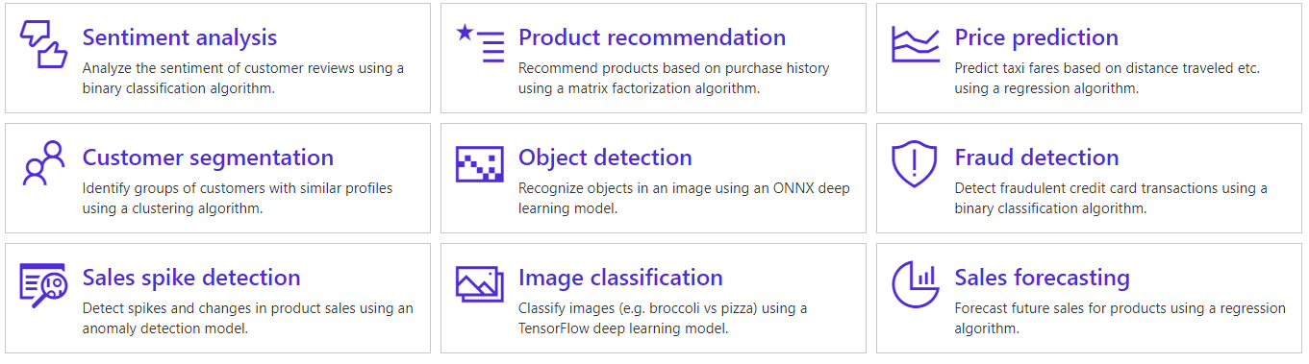
ML.NET Capabilities
Notes:
ML.NET can do tons of stuff. Just to mention a few we can do sentiment analysis, production recommendation, price predictions and so forth.
A note to emphasize, and what I like about ML.NET is that it focuses on the business problems at hand, rather than directly diving in to the machine learning task or algorithm you would like to use.
I will touch upon the difference between Machine Learning and Deep Learning later in this talk, but an important note to make at this stage is that we are currently only able to utilize pre-trained Deep learning models in ML.NET, thus we are not able to train them ourselves.
This means that although computer vision is supported in ML.NET, you are not able to train your own models to do so, but rather have to rely on third-party pre-trained models.

Slide 33


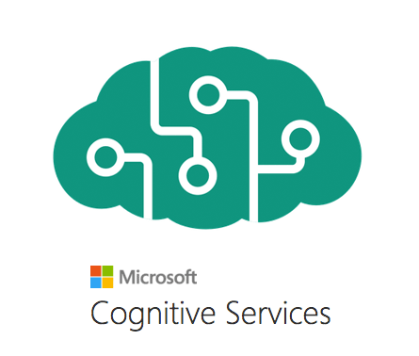


The Landscape
Easier/Less Control
Harder/More Control
Notes:
The Machine Learning and AI landscape is very competitive. There is a flora of available options out there, depending on your needs and ML.NET is just one of many options.
Some of you may be familiar with Azure Machine Learning Studio or Azure Machine Learning Service, you may find this product to the left in this slide together with Azure Cognitive Services. These technologies are in general easier to get started with, but offers you less control as in particular Azure Cognitive Services, which pre-dominantly offers pre-trained models that you pay to utilize.
This may be great for many scenarios, but if you ever want to build a custom model based on your own data, those services will not be enough.
This is where products such as ML.NET comes in to play, which allows you to build completely custom machine learning models.
Although slightly more difficult to master, they provide you with the control needed in many real-world scenarios.
You may also find other products in this space such as Scikit learn and TensorFlow, which is Google's flagship product for deep learning.
We will touch upon this later in this talk, but you can actually use a deep learning model from TensorFlow with ML.NET.
This is made possible by an open-standard called ONNX, which is backed by Google, Microsoft and Facebook.

Slide 34
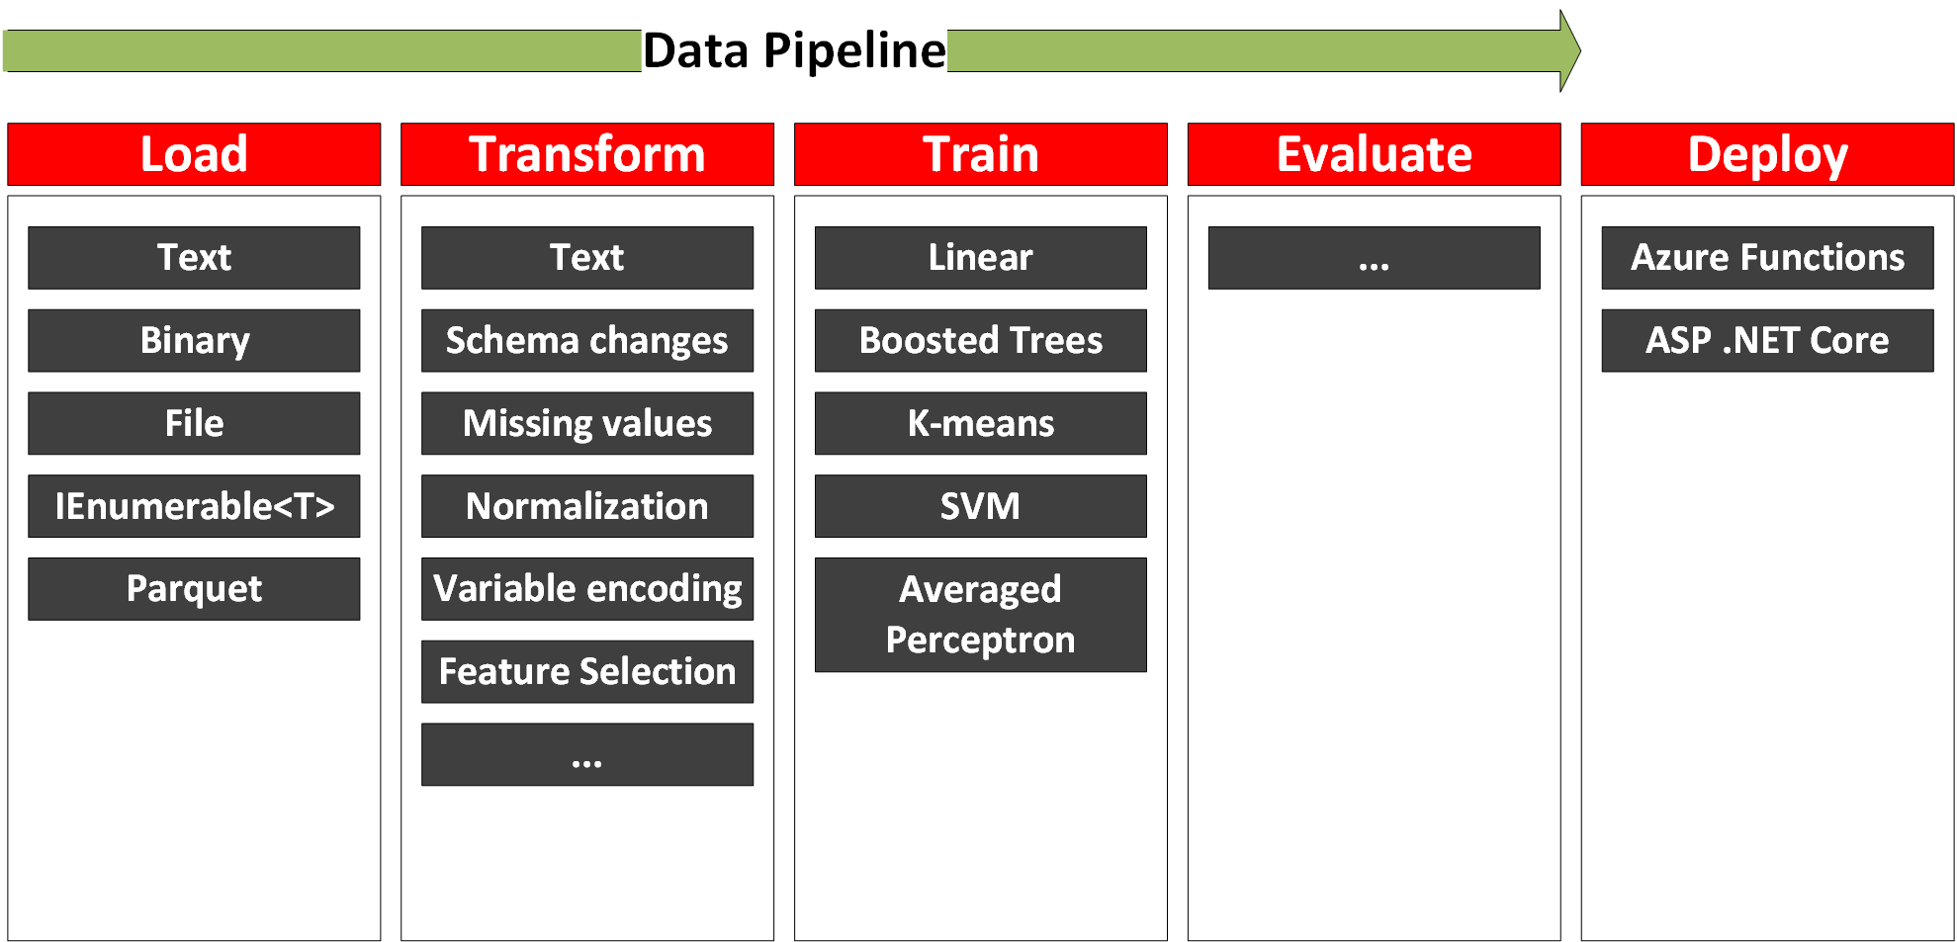
Machine Learning Workflow (ML.NET)
Notes:
So if we take the Machine Learning context and look at how each part of it can be translated to the features and functionality of ML.NET, what do we get.
Firstly, given that we have identified our problem and gathered our data, we can load it using a number of different ways...
We can then transform it...
And finally select a trainer and evaluate it.
The functionality to do all of these operations resides on something called the MLContext which is a ML.NET construct. The object, holds all of the namespaces or catalogus of features needed to train your model.
Using the MLContext we can create data processing and training pipelines, on which we can append transformers and trainers of our chosing.
The final model is then saved as a .zip file, which we can deploy to whereever we like, e.g. blob storage or include as part of an application.

Slide 35
Tutorial
Train a model in ML.NET

Slide 36
Break

Slide 37
Part 2
Real-Time Stream Processing
Azure Stream Analytics

Slide 38
Agenda
Part 2 (50 min)
Introduction to Stream Processing
Introduction to Azure Stream Analytics
Set up our Azure Stream Analytics job
Notes:
So what are we going to talk about today?
We are going to get started with looking at ML.NET and it's history and then fairly quickly transition in to uncovering the concepts behind the buzzwords Machine Learning and Deep Learning.
Although ML.NET makes Machine Learning a lot easier to perform, it is important to know some of the basics to follow along in discussions as well as when building out your code base.
Once we have a good understanding of the concepts, we will take a step back and look at the overall machine learning workflow that we can use to train our own model.
My hope is that we will spend about half of this talk on doing some live coding, where we will be training our own model using the framework.

Slide 39
What is Real-Time Stream Processing?

Slide 40





Notes:
Bank fraud
Washington DC – giving a fine if you speed through an intersection
Tolls or real time monitoring of traffic patterns
Predicitve maintenance
Industrial factories and monitoring of pressure valves or processers (one would normally include IoT Edge in this scenario
Autonomous cars, start, stop and turn based on live feedsq a

Slide 41
What is a stream?
Continuous
Stems from multiple sources
Small (Kb)
Timestamp/value
Notes:
Three pillars
What is a stream really made up off?

Slide 42
Batch vs Stream Processing
 | Batch Processing | Stream Processing
Data Volume | Large volumes | Small volumes
Query Processing | Entire dataset | Subset of data
Query Latency | Minutes to hours | Milliseconds to seconds
Data Insight | Processed hourly to daily | Near real-time insights

Slide 43
Technologies

Slide 44
Streaming Technologies
 | Azure Stream Analytics | HDInsight with Spark Streaming | Apache Spark in Azure Databricks | HDInsight with Storm
Programmability | ASQL, JavaScript | Scala, Python, Java | Scala, Python, Java, R | Java, C#
Programming paradigm | Declarative | Declarative and Imperative | Declarative and I mperative | Imperative
Pricing model | Streaming units | Per cluster hour | Databricks units | Per cluster hour
*Azure Functions
*Azure WebJobs

Slide 45
Azure Stream Analytics

Slide 46
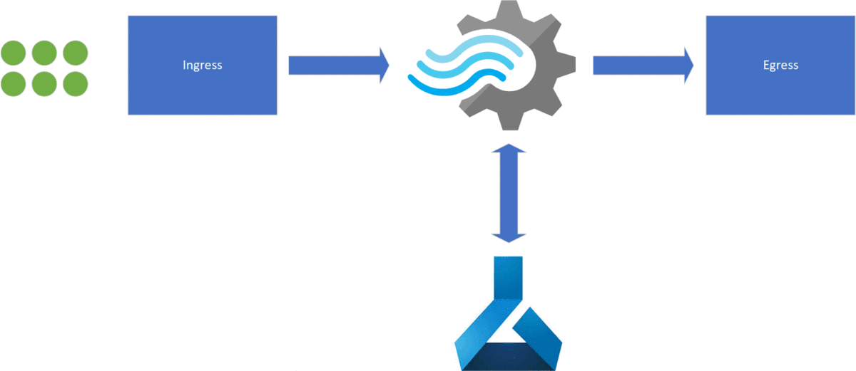
Azure Stream Analytics

Slide 47




Ingress

Slide 48






Egress
Notes:
Microsoft Quiz
PBI
Azure Functions
Blob Storage
EventHub
SQL Server
Table storage
MessageBus
Data Lake

Slide 49
Temporal Windows
Notes:
- Every data we stream needs to have a timestamp associated with it
- We can either use the application timestamp or just use a system timestamp as it enters
- Windows basically creates a table which we can query
- Difference between time of arrival and application time (!)

Slide 50
Tumbling window
GROUP BY TumblingWindow(minute, 1)
Notes:
You can group your data in to temporal windows in order to perform the analysis on the moving data stream.
A tumbling window splits the analysis in non-overlapping equal size temporal windows
A tumbling window is very usefult to for example answer the question Tell m e the count of tweets for every 10 seconds internval

Slide 51
Hopping window
GROUP BY HoppingWindow(Duration(minute, 1), Hop(second, 5))
Notes:
Every 5 seconds tell me the count of tweets we have over the last 10 seconds
Smooths out the trends of the data
Windows overlap
An event can fall between two distinct windows

Slide 52
Sliding window
GROUP BY SlidingWindow(seconds, 10) HAVING COUNT(*) > 10
Notes:
- Give me the count of tweets for all topics which are tweeted more than 10 times in the last 10 seconds

Slide 53
Temporal SQL

Slide 54
Azure Stream Analytics - SQL
SELECT *
INTO output
FROM input
GROUP BY TumblingWindow(minute, 1)
Notes:
- This is the basic structure of Azure Stream Analytics SQL
Notice the following
1. We select into something, from something (egress and ingress)
2. We normally group by a temporal window for any aggregation functions
3. The events are normally in an object structure. We can access properties or arrays on the objects easily

Slide 55
Built-In Functions
Analytic LAG
ISFIRST
FIRST
ISLAST
LAST
ANOMOLYDETECTION
Array Functions
GETARRAYLENGTH
GETARRAYELEMENT
GETARRAYELEMENTS
Conversion CAST
GETTYPE
TRY_CAST
Geo Spatial
CREATELINESTRING
CREATEPOINT
CREATEPOLYGON
ST_DISTANCE
ST_OVERLAPS
ST_INTERSECT
ST_WITHIN

Slide 56
Performance and Scaling

Slide 57
Scaling and Pricing
CPU + Memory + Storage => Streaming units (SU)
$0.11 h per SU = $82/month
Max 192 SU per job
Query Performance

Slide 58
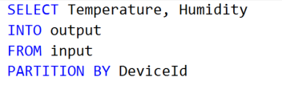
Performance
Use PARTITION BY to run in parallel
An EventHub has 2-32 partitions
Not all jobs are possible to run in parallel

Slide 59
Tutorial
Setup our real-time stream processing pipeline

Slide 60
Break

Slide 61
Part 3
Azure Machine Learning Service

Slide 62
Agenda
Part 1 (50 min)
Introduction to Azure ML Service
Train our model in Azure ML Service
Notes:
So what are we going to talk about today?
We are going to get started with looking at ML.NET and it's history and then fairly quickly transition in to uncovering the concepts behind the buzzwords Machine Learning and Deep Learning.
Although ML.NET makes Machine Learning a lot easier to perform, it is important to know some of the basics to follow along in discussions as well as when building out your code base.
Once we have a good understanding of the concepts, we will take a step back and look at the overall machine learning workflow that we can use to train our own model.
My hope is that we will spend about half of this talk on doing some live coding, where we will be training our own model using the framework.

Slide 63
Azure Machine Learning Service
Cloud service to train/manage/deploy ML models
Replaces Azure Machine Learning Studio
Various levels of complexity
Visual interface
AutoML
Jupyter Notebooks
MLOps

Slide 64
Jupyter Notebooks
Successor of IPython Notebook
Julia + Python + R = Jupyter
Cells and Kernels
Premier development environment for Data Science
Local or in the cloud

Slide 65
Open Neural Network Exchange (ONNX)
Backed by Microsoft, Google, Facebook
Transformation of models to an open format
A means to use Deep Learning models in ML.NET

Slide 66
Tutorial
Train a model using
Azure Machine Learning Service

Slide 67
Thank you!
Twitter:
@alexslotte
Material:
bit.ly/2Pc1HgC
Feedback greatly appreciated

